Slide 1
Bridging the gap between your journal and your authors
Clarinda Cerejo
Editor-in-Chief, Editage Insights
Editage
2016 ACSE Annual Conference, Aug 10-11, Dubai, UAE
Notes:
Hi everyone,
I’m Clarinda Cerejo, Editor-in-Chief of Editage Insights, a learning resource platform for authors and journals. Today, I’m going to talk about how journal editors, publishers, and academic societies can get closer to your authors. I hope to make this an interesting session and give you with lots of new insights and key takeaways. But I feel quite lonely up here, so it’d be great if you could help me out and respond when I throw questions at you or ask for a show of hands.
We’ll take a break at about 10:15. We’ll have an activity in between, so I hope you all have pencils or pens? And we’ll end with a Q&A session, so make a note of all your questions and ask me then.
To start with, let me get to know you a little bit. Show of hands: How many of you are journal editors - Editors in Chief, Managing Editors? How many publisher representatives? Publishing Directors? Publishing Liasons? How many university representatives? And Others? Could a couple of you share your designations? And what are you expecting from this session? Anyone else? What are you expecting to learn?

Slide 2
Inside the mind of a young researcher
Why are all resources on
research publication
only in English?
Even after I have followed ethical
guidelines, the journal editor says
I have plagiarized!
I find it so difficult to select a journal and prepare my manuscript.
I wish I knew what journal
editors want so that I can
communicate with them
better.
I wish I had a coach to teach me about journal publication!
I don’t understand anything about data sharing and open access

Slide 3
Inside the mind of an editor
All these requests for rapid publication…and yet another peer reviewer turning down my invitation!
Why can’t authors just follow the simple formatting guidelines?
Seems like plagiarism. So much to educate authors about!
I’m just swamped with submissions, and most of them don’t even match my journal’s scope
Wish I could understand my authors and tell them exactly what we’re looking for in submissions.
Notes:
Let’s begin by stepping inside the mind of a journal editor.
Look familiar? Been there, done that? Then this session is just for you!

Slide 4
Mismatch in perspectives of authors and editors
Authors think…
They understand publication ethics and do the best they can to adhere to standard guidelines
They address and respond carefully to all peer reviewer comments
Journal instructions for authors are often incomplete and unclear
Editors think…
Authors don’t realize the importance of publication ethics
Authors only address the peer reviewer comments they find agreeable
Journal instructions for authors are generally clear and complete
From C. Cerejo. International journal editors and East Asian authors: two surveys. Learned Publishing 27(1) 63-75.

Slide 5
Author complaints – true story!
I have a submitted a review to a journal having impact factor 20+ . I know the journal usually takes a long time. In my case, it has been about one year and my article is still under review. I contacted the editor few times and they informed me that they need more time since they have not received enough reviews to make a final decision. My concern is if they reject my manuscript at this stage, I will be in trouble since I have to thoroughly modify it to submit to a new journal due to recently published papers. Since that type of journal sends less than 20% of the submitted manuscript for external review, I believe that the editor thought my work valuable for their journal. Can you tell me how the editor will react if they don’t get favorable comments from the reviewers on my manuscript? In my opinion, if they delay this much and reject, it can destroy a good manuscript since another one might get published during that period.

Slide 6
Challenges authors face – questions we receive
I submitted my article to a fairly well-respected (but not outstanding) law journal, received a reply from the editor a couple of weeks later saying they had sent it for review and expected to get it back in 6 weeks. 12 weeks later, I sent a polite query. Editor then responded within a week and said he'd get it back to me in 2 weeks. It's now been 3 1/2 weeks, and I'm in a bit of a "publish or perish" situation at work. Any thoughts on how to proceed? Withdrawal is too drastic at this stage, as I certainly don't want to annoy the editor.

Slide 7
Pressure on journal editors
Ever-increasing submission volumes
Author demand for rapid publication
Difficulty in finding suitable peer reviewers
Need to identify and appropriately tackle increasing cases of misconduct
Increased competition with other journals
New industry developments to keep pace with --- peer review, open access, etc.

Slide 8
How can journal editors beat the pressure?
By bridging the gap and getting closer to your authors!
But HOW?

Slide 9
What if there was…
A one-stop platform that
Educates editors about the pain points of authors and the questions they are asking
Enables editors to talk directly to authors about journal processes
Offers authors learning and advice on good publication practices
Informs editors about new developments and global trends in the industry

Slide 10
There is!
Discussion on industry hot topics like peer review and open access
Tutorials on all aspects of journal publication
Available in 4 languages
TM
Interviews with journal editors and industry experts
Workshops and webinars
Q&A forum for authors

Slide 11
What is Editage Insights?
A global learning and discussion platform for authors and journals
Rapidly becoming the world’s most trusted educational resource for researchers
Resources in four languages
EN
JP
www.editage.com/insights
www.editage.jp/insights
KR
CN
www.editage.co.kr/insights
www.editage.cn/insights

Slide 12
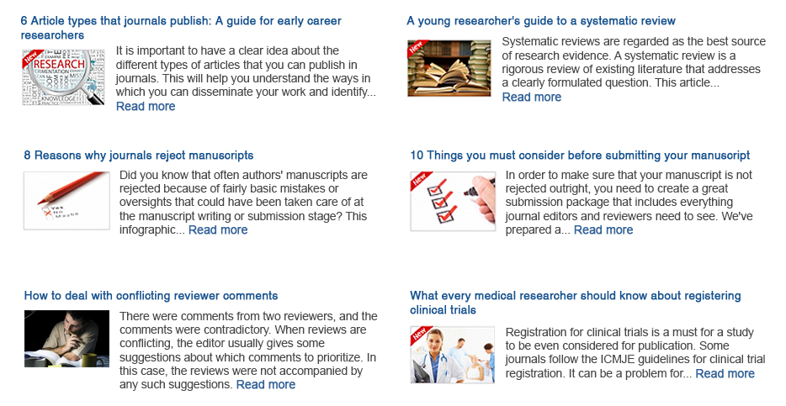
Tutorials on all aspects of academic publication

Slide 13
Guidance at every stage of the publication process
Notes:
Necessary foundation for publication is to write a research paper in English and understand how publication process works. Editage Insights covers wide range of scientific English writing tips and detail instructions to pass each publication stages.

Slide 14
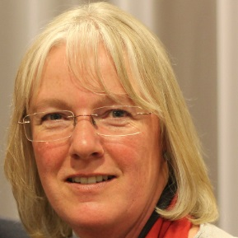
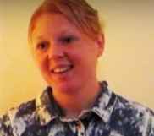
Expert interviews giving authors and editors advice and tips
What makes a great submission package?
Navigating through peer review
Dr. Bruce P. Dancik
Dr. Leslie Citrome
Editor-in-Chief, NRC Research Press/Canadian Science Publishing
Editor-in-Chief, International Journal of Clinical Practice
Everybody faces manuscript rejection, even a Nobel Laureate
What makes a good manuscript, tips for ESL authors, and more!
Dr. Tim hunt
Dr. Christian Sterken
Nobel Laureate
Author of Scientific Writing for Young Astronomers
"Almost every editor I have ever met has a problem with finding good quality peer reviewers"
How the DOI ensures persistence and traceability of published papers
Pippa Smart
Rachael Lammey
Publishing consultant
Product Manager, CrossRef

Slide 15
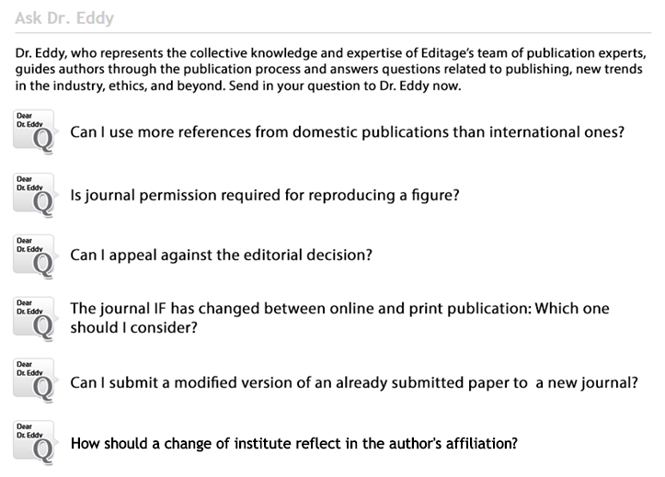
Q&A forum for researchers
Notes:
Necessary foundation for publication is to write a research paper in English and understand how publication process works. Editage Insights covers wide range of scientific English writing tips and detail instructions to pass each publication stages.

Slide 16
News, trends, and hot discussions from the publishing industry
Notes:
Editage Insights is designed as an interactive learning forum for authors. Authors can make use our videos and presentations to do self-learning. What’s more, we have expert to help authors resolve their queries while going through the publication process. Authors can send questions to Dr. Eddy on any aspect of publication and receive answers in Korean.

Slide 17
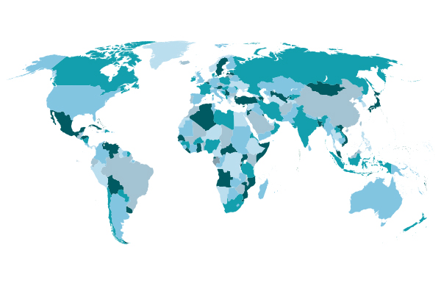
Growth and reach
Users per month
Countries reached
Launched in November 2013, Editage Insights currently reaches over 120,000 users every month, has users from
every country in the world, and features more than 1200 content items

Slide 18
View counts of popular articles
How to write an effective title and abstract and choose appropriate keywords
339,245 views
Tips on effective use of tables and figures in research papers
191,151 views
Peer review process and editorial decision making at journals
154,316 views
Tracking your manuscript status in journal submission systems
107,792 views
The correct way to report p values
96,079 views
How to respond to comments by peer reviewers
81,603 views

Slide 19
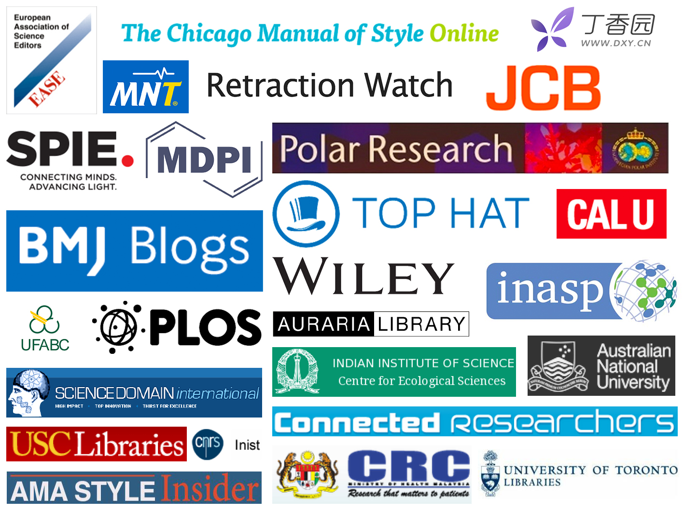
Cited on >530 academic sites
Notes:
Some links where we’re mentioned: http://www.cdnsciencepub.com/learning-centre/research-and-writing/ https://hub.wiley.com/community/exchanges/discover/blog/2015/08/20/8-reasons-why-journals-reject-manuscripts https://pkp.sfu.ca/editorial-resources/

Slide 20
Now your authors can access Editage Insights through your journal’s website!

Slide 21
Get the Editage Insights plug-in!
Installing the Editage Insights plug-in on your journal’s website will allow you to
Provide a steady stream of learning resources for your authors
Avoid the time and resource investment required to create original content
Improve communication with your authors
Develop your brand as a trusted source of knowledge
Make your journal more author friendly!
Notes:
View it anytime anywhere
Localized social sharing features, authors can easily share the articles they like with friends in one click
Most other content sites only allow global subscription to all categories, so you have to screen the alerts to find information relevant to you. But on Editage Insights, you can subscribe to only the content that matters to you and get notification whenever new content in these categories is published.
Filter content on the basis of category, format and redaing length. Search for topics that interest you view the content in the format you like

Slide 22
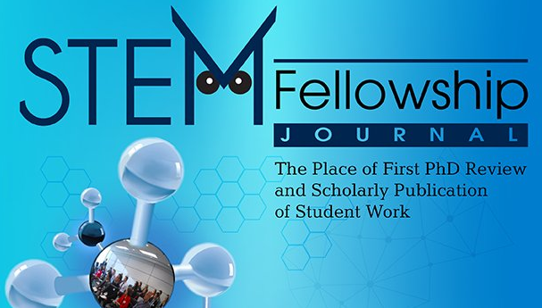
Publishers/organizations featuring Editage Insights content on their website

Slide 23
Points to remember
Authors are at the center of your journal’s success
With open access and the author-pays publishing model, the author is now your customer
Becoming more author centric will increase your reach and improve the quality of submissions

Slide 24
Get closer to your authors
Understand their main pain points
Communicate exactly what you are looking for in submissions
Direct authors to resources on good publication practices
Offer publication support and author education
Stay updated on global trends in the industry

Slide 25
Get closer to your authors today!

Slide 26
About Editage
A brand of Cactus Communications, established in 2002
Leading provider of editing and publication support services to authors, journals and publishers
Offices in the US, India, Japan, China, Singapore, and South Korea, and local representatives in Brazil, Taiwan, and Turkey
Partnerships with many major publishers and societies to offer authors discounted editing services – Wolters Kluwer, Hindawi, Canadian Science Publishing, Institute of Physics (IOP), Institution of Engineering and technology (IET), etc.
Manuscript preparation
Manuscript writing
Academic translation
Pharmaceutical support
Manuscript editing
Journal formatting
Artwork, graphs, tables
Rapid technical review for scientific validity
Journal selection and submission
Journal recommendation tools and services
Manuscript submission support services
Manuscript re-editing
Peer review response check
Re-submission support

Slide 27
Presenter’s Contact Details
Clarinda Cerejo
Editor-in-Chief, Editage Insights
ORCID: http://orcid.org/0000-0003-3161-6951
Twitter: @ClarindaCerejo
Email: clarinda.cerejo@editage.com
Phone: +1(267) 332-0051 ext. 200
Fax: +91 22 6714 8889
Editage Insights
English: www.editage.com/insights
Simplified Chinese: ww.editage.cn/insights
Japanese: www.editage.jp/insights
Korean: www.editage.co.kr/insights
Twitter: @Editage

